Slide 1
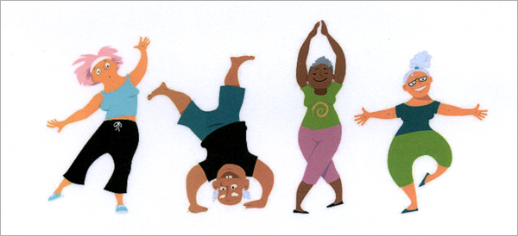
UNIT 2: YOUR BODY AND YOU Lesson 7: Communication and Culture

Slide 2
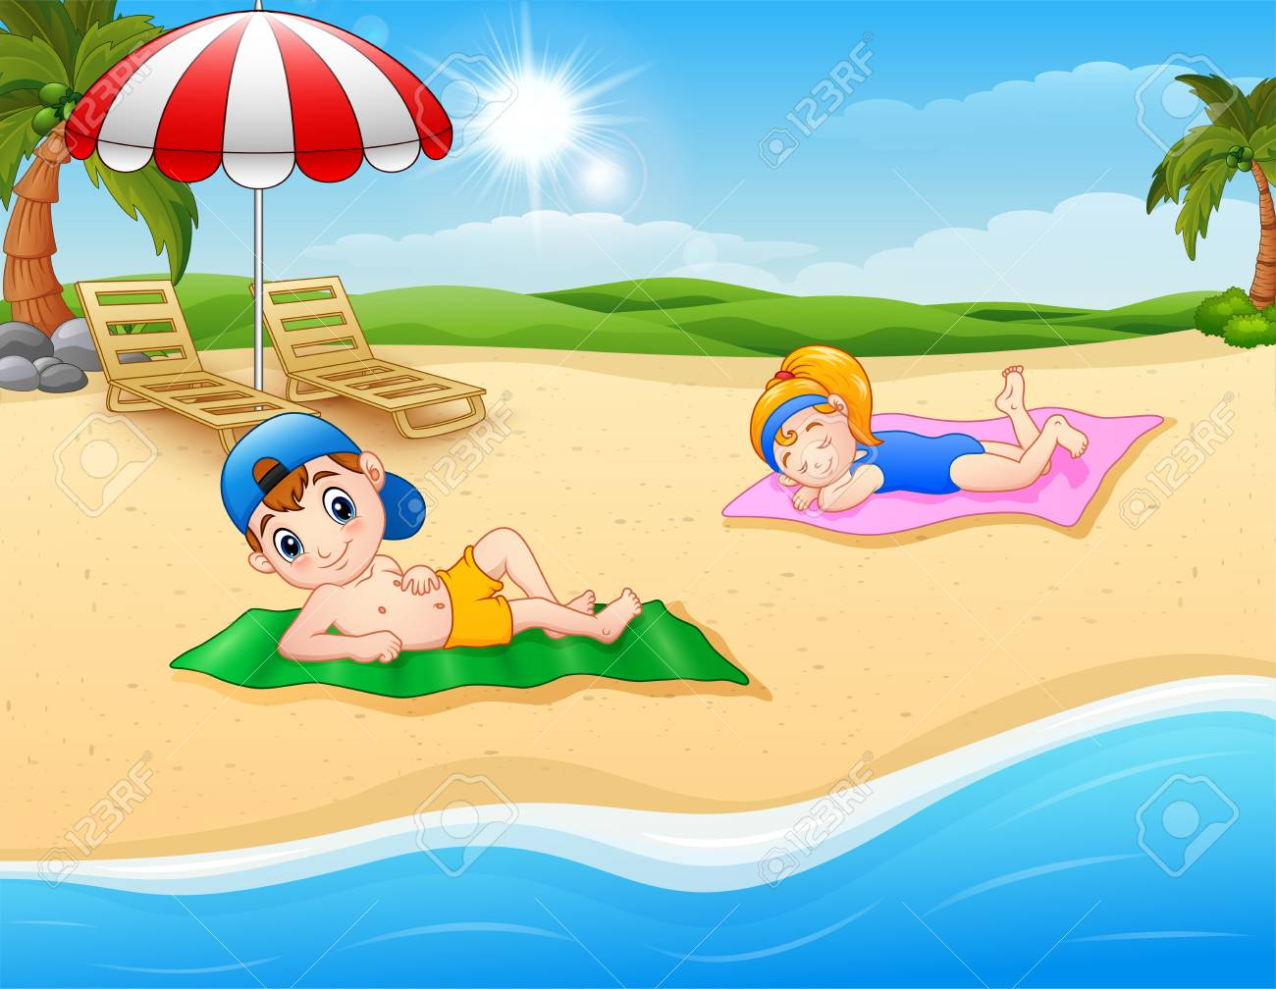
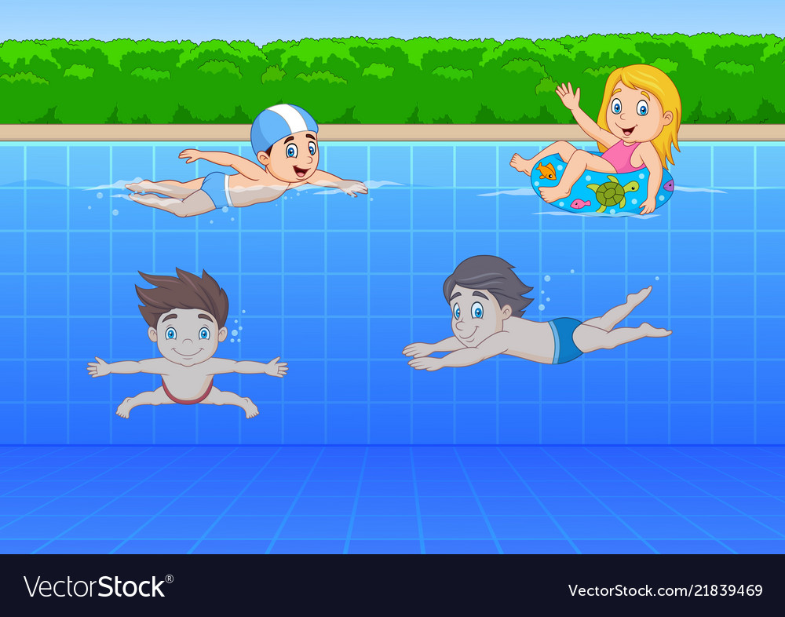
I. Communication
Task 1: Look at the pictures
Which parts/ systems of the body does each activity possibly benefit?
2
3
1
Systems of the body: skeletal system; circulatory system; respiratory system…
Parts of the body: bones; arms; shoulder; nose,…

Slide 3
I. Communication
Task 2: Discuss the activities in the pictures and say why they are healthy
Sunbathing is helpful because:
get enough vitamin D
stimulate bones
help blood circulate better
reduce blood pressure
….
1

Slide 4
I. Communication
Task 2: Discuss the activities in the pictures and say why they are healthy
2
Doing exercises is good for our health because:
strengthen our bones and muscles
control our weight
make us sleep better
reduce stress
digest the food quickly
….

Slide 5
I. Communication
Task 2: Discuss the activities in the pictures and say why they are healthy
Swimming is healthy because:
help us to control our breath
stimulate bones
help us burn calories
….
3

Slide 6
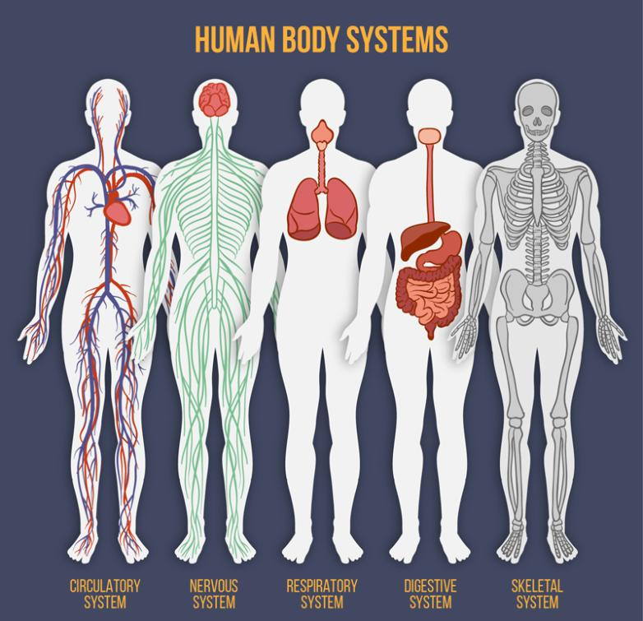
I. Communication
Task 3: Choose a system of the body and make a list of all the possible activities that are good for it.

Slide 7
II. Culture

Slide 8
II. Culture
Task 1: Read about some traditional health beliefs and practices in Vietnam and Indonesia

Slide 9
VIETNAM
INDONESIA
-Ailments are caused by an imbalance of yin and yang
-Illness are caused either naturally or personally
-Herbal medicines and indigenous folk practices used to treat the sick.
-Traditional treatments, herbs and therapies used to treat the sick.
-Goals to restore the yin and yang balance
-Goals to restore normal, proper and comfortable condition
-Previously thought ineffective but recent evidence shows positive health outcomes
-Efficient, safe, cost-effective, affordable and accessible, especially for the poor.

Slide 10
II. Culture
Task 2: Discuss the similarities and differences in health beliefs and practices between the two countries.

Slide 11
VIETNAM
INDONESIA
-Ailments are caused by an imbalance of yin and yang
-Illness are caused either naturally or personally
-Herbal medicines and indigenous folk practices used to treat the sick.
-Traditional treatments, herbs and therapies used to treat the sick.
-Goals to restore the yin/yang balance
-Goals to restore normal, proper and comfortable condition
-Previously thought ineffective but recent evidence shows positive health outcomes
-Efficient, safe, cost-effective, affordable and accessible, especially for the poor.

Slide 12
VIETNAM
INDONESIA
-Ailments are caused by an imbalance of yin and yang
-Illness are caused either naturally or personally
-Herbal medicines and indigenous folk practices used to treat the sick.
-Traditional treatments, herbs and therapies used to treat the sick.
-Goals to restore the yin/yang balance
-Goals to restore normal, proper and comfortable condition
-Previously thought ineffective but recent evidence shows positive health outcomes
-Efficient, safe, cost-effective, affordable and accessible, especially for the poor.

Slide 13
VIETNAM
INDONESIA
-Ailments are caused by an imbalance of yin and yang
-Illness are caused either naturally or personally
-Herbal medicines and indigenous folk practices used to treat the sick.
-Traditional treatments, herbs and therapies used to treat the sick.
-Goals to restore the yin/yang balance
-Goals to restore normal, proper and comfortable condition
-Previously thought ineffective but recent evidence shows positive health outcomes
-Efficient, safe, cost-effective, affordable and accessible, especially for the poor.

Slide 14
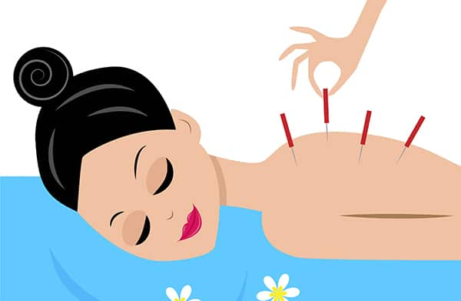
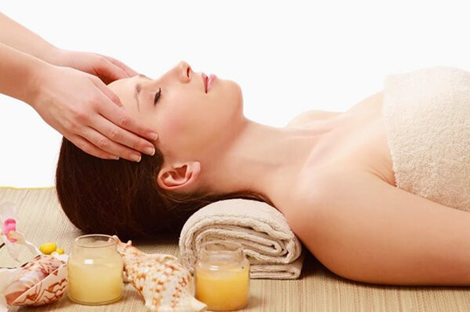
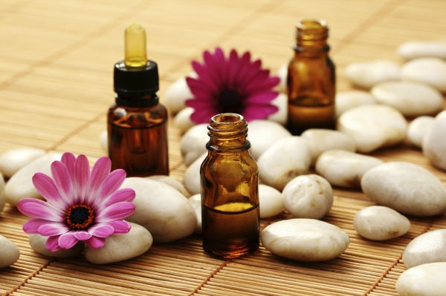
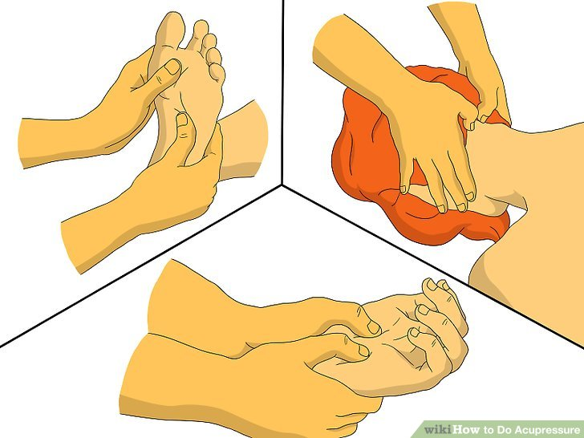
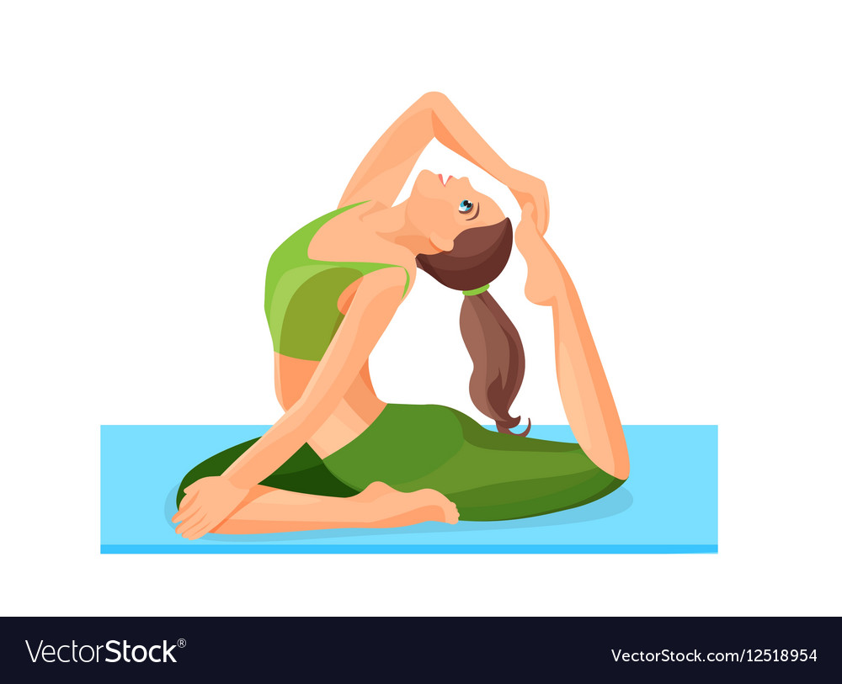
II. Culture
Task 3: Do you know any traditional therapy (treatment without medicine)?
Acupuncture
Aromatherapy
Acupressure
Yoga….

Slide 15
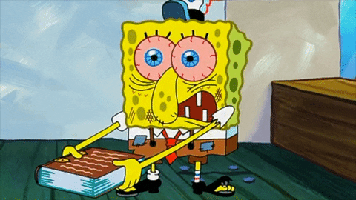
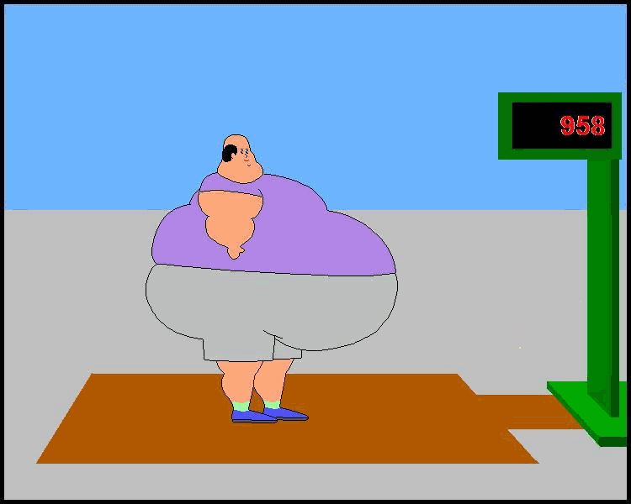
Doctor+Panic

Slide 16
Thank you for your attention

Slide 17
I. Communication
Task 3: Choose a system of the body and make a list of all the possible activities that are good for it.
Circulatory system:
+ Walking
+ Jogging
+ Practicing yoga
+ Eating oily fish
+ Maintaining a healthy weight

Slide 18
I. Communication
Task 3: Choose a system of the body and make a list of all the possible activities that are good for it.
Digestive system:
Walking
Limiting fatty foods
Avoiding the bad habits: smoking, alcohol
Doing exercises regularly
Drinking water

Slide 19
I. Communication
Task 3: Choose a system of the body and make a list of all the possible activities that are good for it.
Respiratory system:
Increase your walking speed
Maintain a healthy weight
Avoid smoking and smoker lungs
Learn yoga

Slide 20
I. Communication
Task 3: Choose a system of the body and make a list of all the possible activities that are good for it.
Nervous system:
Mediation
Aerobic exercises
Jogging and running
Learn yoga
Group classes

Slide 21
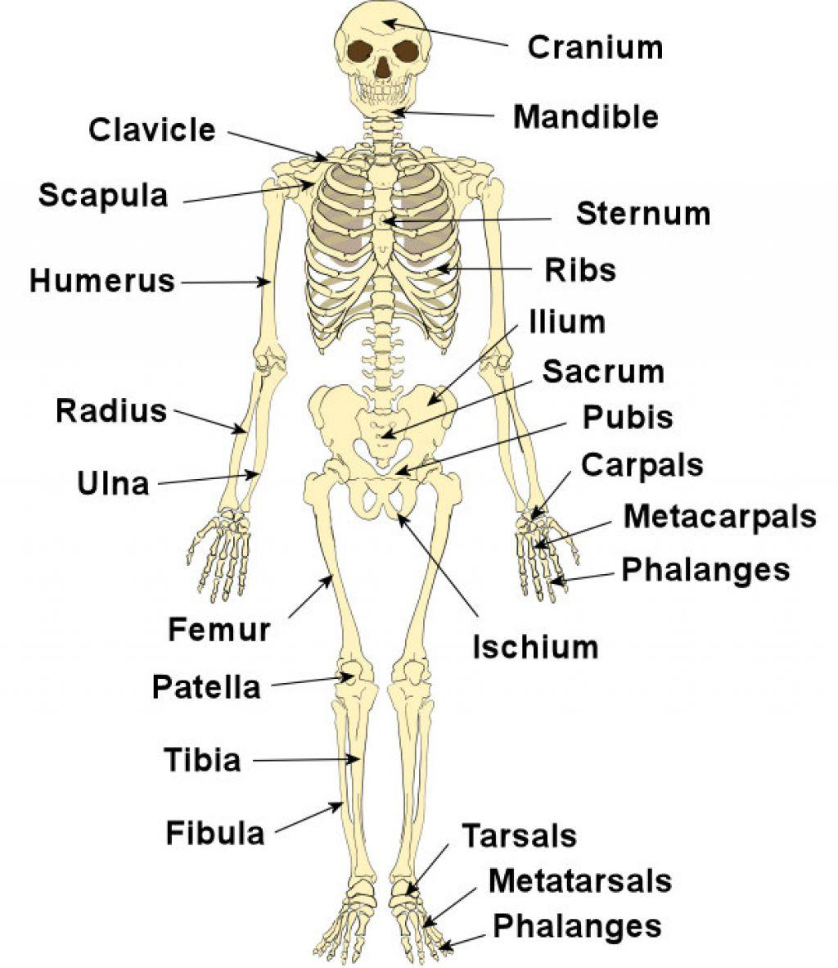
I. Communication
Task 3: Choose a system of the body and make a list of all the possible activities that are good for it.
Skeletal system:
Weight training/ Weight lifting
Walking + Hiking
Jogging
Climbing stairs
Tennis
Dancing

